Slide 1
Arduino STEM Academy
Sensor & Lab Template
Notes:
Steven K. Roberts
From 1983 to 1991, high-tech nomad Steven K. Roberts pedaled 17,000 miles around the United States on a computerized and networked recumbent bicycle, the BEHEMOTH (Big Electronic Human-Energized Machine, Only Too Heavy). Now, Roberts has retired the .2 million BEHEMOTH to build a pair of canoe-based amphibian pedal/solar/sail trimarans known as Microships. This fall, the bike goes on permanent loan to Computer History Museum; in early 2001, Roberts and his partner, Natasha, will launch a multi-year expedition throughout the United States aboard their tiny Linux-powered boatlets.
Prior to Steve's life as a technomad, he owned a consulting engineering business in the Midwest and published three books on microprocessors and industrial control system design. Steve's once-radical notion of "nomadic connectivity" has become a trend as computer and communication tools become ever smaller and more powerful.

Slide 2
See Appendix A, for Licensing & Attribution information
by-nc-sa-3.0
https://creativecommons.org/licenses/by-nc-sa/3.0/
https://creativecommons.org/faq/#what-does-some-rights-reserved-mean

Slide 3
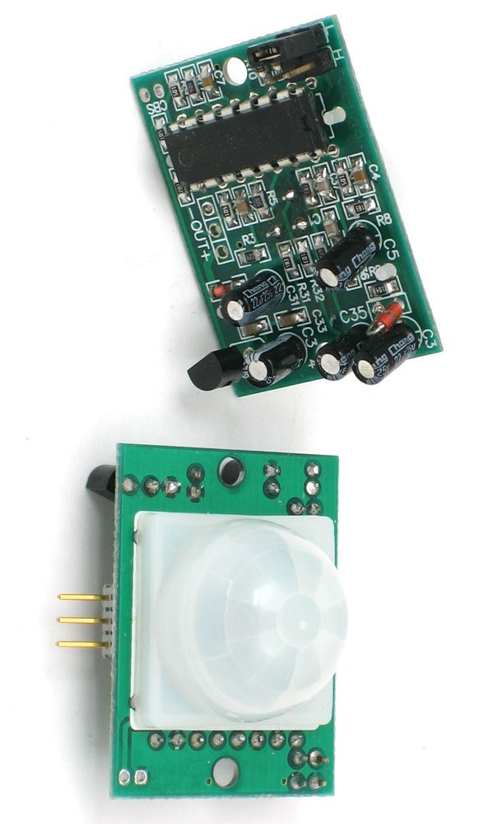
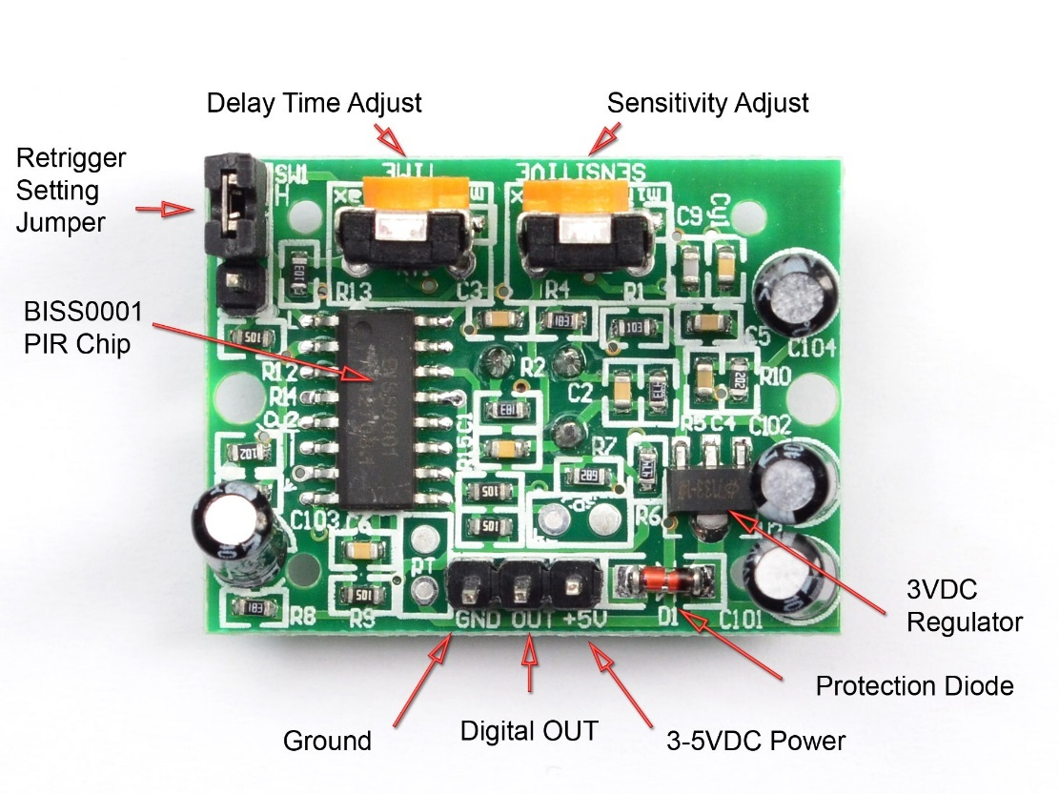
PIR Sensor
https://learn.adafruit.com/pir-passive-infrared-proximity-motion-sensor
PIR sensors allow you to sense motion, almost always used to detect whether a human has moved in or out of the sensors range. They are small, inexpensive, low-power, easy to use and don't wear out. For that reason they are commonly found in appliances and gadgets used in homes or businesses. They are often referred to as PIR, "Passive Infrared", "Pyroelectric", or "IR motion" sensors.
When the detector sees PIR signal, it will pull the output low,

Slide 4
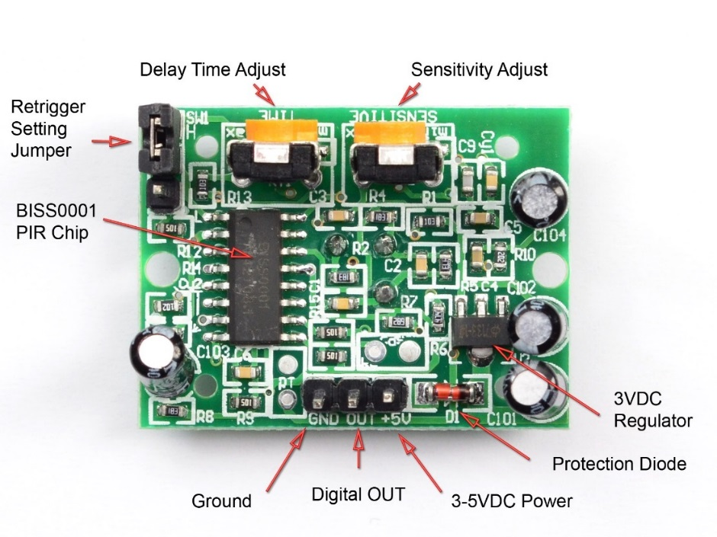
How it Works
Power PIR with 3-5 volts
5 volts seems to work best
Connect +5V to VCC
Connect GND to Ground
Digital OUT is a signal that will be LOW if there is no motion, and HIGH if there is motion
Typically you should let the PIR “warmup” for 30-60 sec after you power on the circuit.
Delay Time Adjust will change the time the PIR is HIGH after it sees motion
Sensitivity Adjust tunes how sensitive to motion the PIR is
The Retrigger Jumper controls if…

Slide 5
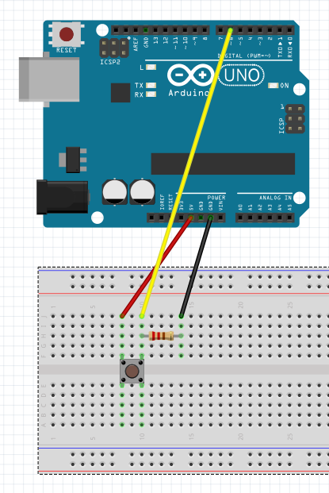
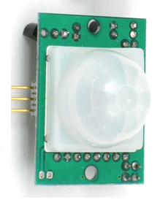
Arduino Code & connections
const int arduinoBoardLED = 13; // LED on pin 13
const int pirSensor = 6; // input pin for sensor
int buttonVal = 0; // variable to store the read value
void setup()
{
pinMode(arduinoBoardLED, OUTPUT); // set pin 13 as output pinMode(pirSensor, INPUT); // set pin 6 as input
}
void loop()
{
buttonVal = digitalRead(pirSensor); // read the input pin digitalWrite(arduinoBoardLED, buttonVal); // sets the LED to button's value
}

Slide 6
Sensor LAB
Add instructions for building a circuit to test and use this sensor
You can build examples in Tinker and cut and past the image here…
If you want, you can send me your code, and after we verify it works, I can post it on my GitHub site… or you can create and post to your own GitHub site.

Slide 7
Sensor Lab Steps
Step by Step how to setup
Step by Step on connecting to the Arduino
<Link to your code>
Step by Step on how to verify it is working
Any trouble shooting tips for issues that could go wrong or get in the way

Slide 8
Appendix

Slide 9
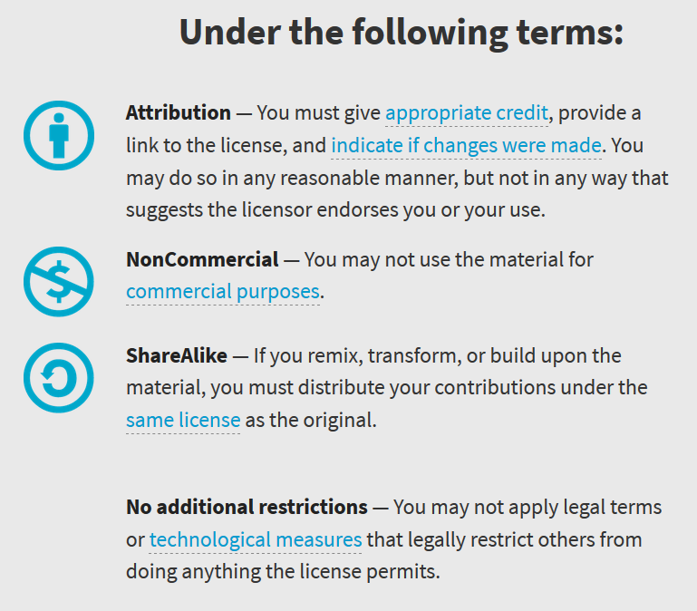
Appendix A: License & Attribution
This content is primarily the Intellectual Property of <add your name here>
This presentation and content is distributed under the Creative Commons License CC-by-nc-sa-3.0
My best attempt to properly attribute, or reference any other sources or work I have used are listed in Appendix B

Slide 10
Appendix B: Attribution for Sources Used
Add any links to sites you used here…

Slide 11
Reference Slides

