Slide 1
Stage 1: Problem Identification
Problem Areas for Consideration
Human Performance
Disease Prevention
Disease Detection
Injury/Illness Diagnosis
Injury/Illness Monitoring
Treatment
Application Areas
Fitness/Wellness
Occupational
Extreme Performance
Clinical/Health
Context
Define the problem or opportunity creating the need for your product
This Photo by Unknown Author is licensed under CC BY

Slide 2
Stage 1: Problem Identification
Topic Overview: What problem are you aware of that warrants an innovative and creative solution?
Context/Causes
Symptoms/Problems
Current Treatment/Solutions
Limits of Treatment/Solutions
Other

Slide 3
Stage 2: Problem - Product Fit
This stage is centered on the development of your product. Consider the factors below as you conceptualize your device.
Device Purpose
Sense/Predict
Diagnose/Assess
Treat
Cure
Communication
Printed antenna
Bluetooth
Wifi
Sensor Options
Temperature
Chemical changes
Humidity
Shock
Acceleration
Fluids
Gases
Physical Proximity
Elevation
Infrared
Challenges
Clinical Acuity: robust, reliable decision-making tools
Power: flexible batteries, power management
User Experience: Wearable form-factor, lifetime, caregiver workflow
Communications: security, data continuity
User and User Interface
Failure modes
Biocompatible
Application Areas
Fitness/Wellness
Occupational
Clinical
Extreme Performance
Military/Defense
Commercial
Power Source
Hydro
Solar
Rechargeable
Form Factor
Bracelet
Patch
Robotic appendage
Clothing
Features and Functionality
Users & user interface
Key components
Environment: Biocompatible? Ruggedized?
Desired function
Smart Analytics
Failure modes
Actuators/Performance:
Chemical release
Physical/Magnetic propulsion
Communication/alert
Ultrasonic
Soft Robotics

Slide 4
Stage 2: Underlying Technology
What is your device’s purpose?
What applications can it be used for?
What features does it have?
Describe the shape (Form Factor)
How does it incorporate FHE functionality?
What do the sensors sense?
What does it do when it senses something its programmed to recognize? (Actuators)
How is it powered?
How does it communicate with other devices?

Slide 5
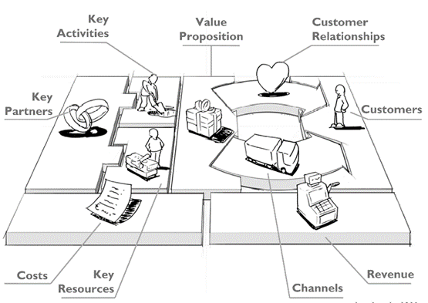
Stage 3: Product-Market Fit
(Business Model Development)
In this stage, you will organize your issue and device into a business model canvas. This is simply a way to determine if your idea has value through the hypothesis and testing process.
“[Business models] are, at heart, stories—stories that explain how enterprises work. A good business model answers [the] age-old questions: Who is the customer? And what does the customer value? It also answers the fundamental questions every manager must ask: How do we make money in this business? What is the underlying economic logic that explains how we can deliver value to customers at an appropriate cost?”
-Joan Magretta, “Why Business Models Matter”, Harvard Business Review, May 2002
Context
Define the problem or opportunity creating the need for your product
Value Proposition
What gain do you provide or pain do you solve?
Underlying Technology
How does your product work?
Go To Market Strategy
Who are your key partners? How will you reach, acquire, and maintain customers?
What is your competitive advantage?
Competitive Landscape / Unique Solution
What products will you be competing against?
How is your product different?
Target Market
User vs Buyer
Business to Business vs Business to Customer
Financials
Costs, Revenue, and profit?

Slide 6
Stage 3: Product-Market Fit
(Business Model Development)
Go To Market Strategy:
Key Partners:
Unique Solution: What does the competitive landscape look like? How is your product different from similar devices on the market?
Target Market (Users):
Target Market (Buyers):
Financials:

