Slide 1
Binary Worksheets & Handouts

Slide 2
See Appendix A, for Licensing & Attribution information
by-nc-sa-3.0
https://creativecommons.org/licenses/by-nc-sa/3.0/
https://creativecommons.org/faq/#what-does-some-rights-reserved-mean

Slide 3
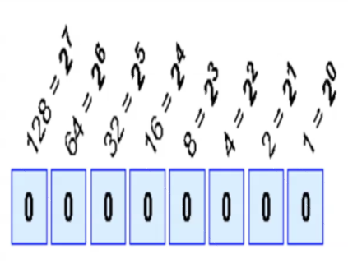
Convert the Following Binary Numbers:
101 = 6 1x4 + 0x2 + 1x1
11 = ______
111 = ______
1010 = ______
01011 = ______
101011 = ______
Extra Credit
1101011 = ______
Show Your Work
Place Values

Slide 4
Convert the Following Binary Numbers:
11011 = ______
00011011 = ______
11111101 = ______
01111111 = ______
10101011 = ______
Extra Credit
1111101011 = ______
Show Your Work
Place Values

