Slide 1
Let’s Play a Game…
Using binary number system to “magically” guess a secret number

Slide 2
See Appendix A, for Licensing & Attribution information
by-nc-sa-3.0
https://creativecommons.org/licenses/by-nc-sa/3.0/
https://creativecommons.org/faq/#what-does-some-rights-reserved-mean

Slide 3
How this Game works…
How to Play this Game
Print & Cut out the 6 cards below. You are now ready to do the trick.
Give the 6 cards to a friend, and ask them to pick a secret number between 1 and 63, and tell you if their number is on each card. When ever they say yes, add the first top left number. When you have added up the first number of each card they have said yes to, that is the number they picked. Or you could have them give you back all the cards that have their number on it.
You can figure out their secret number by adding together all of the first numbers on the cards they gave back to you. For example, if they gave you back the cards with the top, left, first numbers on these cards are 16 and 4, then their number would be 20, because the these numbers add up to 20.
Why does it work?
Remember how to write the numbers from 1 to 63 in binary? See the last page if you forgot. The sequence of 1's and 0's in a binary number tell us which powers of 2 add up to make the number. For example, 19 = 16+2+1, so in binary we write 10011.
Now notice that the number 19 appears only on the first, fourth, and fifth cards. That is, 19 appears on the cards with first numbers 16, 2, and 1, and it does not appear on the cards 32, 8 or 4.
The 6 cards correspond to the powers of 2. The numbers that are on the first card (with "16" as the first number) are the ones that have a "1" in the 16's position when we write it in binary. The numbers on the "8" card are those with a "1" in the 8 position in binary. And so on for the other cards. So, when you add up first numbers on the cards that a "secret" number is on, you are adding up the powers of two that add up to the secret number!
Online Magic -http://avimagic.com/tricks/number_cards.php

Slide 4
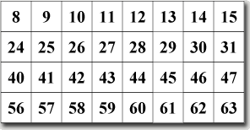
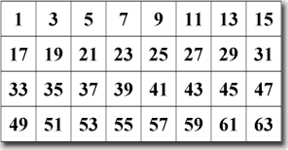
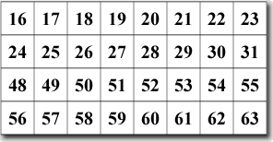
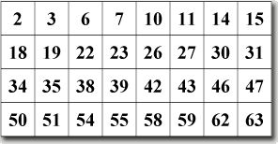
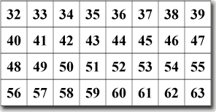
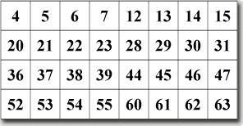
All Six Cards
Cut Out These Cards

Slide 5
Is Your Number on this card?
1 | 3 | 5 | 7 | 9 | 11 | 13 | 15
17 | 19 | 21 | 23 | 25 | 27 | 29 | 31
33 | 35 | 37 | 39 | 41 | 43 | 45 | 47
49 | 51 | 53 | 55 | 57 | 59 | 61 | 63

Slide 6
Is Your Number on this card?
2 | 3 | 6 | 7 | 10 | 11 | 14 | 15
18 | 19 | 22 | 23 | 26 | 27 | 30 | 31
34 | 35 | 38 | 39 | 42 | 43 | 46 | 47
50 | 51 | 54 | 55 | 58 | 59 | 62 | 63

Slide 7
Is Your Number on this card?
4 | 5 | 6 | 7 | 12 | 13 | 14 | 15
20 | 21 | 22 | 23 | 28 | 29 | 30 | 31
36 | 37 | 38 | 39 | 44 | 45 | 46 | 47
52 | 53 | 54 | 55 | 60 | 61 | 62 | 63

Slide 8
Is Your Number on this card?
8 | 9 | 10 | 11 | 12 | 13 | 14 | 15
24 | 25 | 26 | 27 | 28 | 29 | 30 | 31
40 | 41 | 42 | 43 | 44 | 45 | 46 | 47
56 | 57 | 58 | 59 | 60 | 61 | 62 | 63

Slide 9
Is Your Number on this card?
16 | 17 | 18 | 19 | 20 | 21 | 22 | 23
24 | 25 | 26 | 27 | 28 | 29 | 30 | 31
48 | 49 | 50 | 51 | 52 | 53 | 54 | 55
56 | 57 | 58 | 59 | 60 | 61 | 62 | 63

Slide 10
Is Your Number on this card?
32 | 33 | 34 | 35 | 36 | 37 | 38 | 39
40 | 41 | 42 | 43 | 44 | 45 | 46 | 47
48 | 49 | 50 | 51 | 52 | 53 | 54 | 55
56 | 57 | 58 | 59 | 60 | 61 | 62 | 63

Slide 11
Decimal (Base 10 ) | Binary (Base 2)
0 | 0000 0000
1 | 0000 0001
2 | 0000 0010
3 | 0000 0011
4 | 0000 0100
5 | 0000 0101
6 | 0000 0110
7 | 0000 0111
8 | 0000 1000
9 | 0000 1001
10 | 0000 1010
11 | 0000 1011
12 | 0000 1100
13 | 0000 1101
14 | 0000 1110
15 | 0000 1111
Decimal (Base 10 ) | Binary (Base 2)
16 | 0001 0000
17 | 0001 0001
18 | 0001 0010
19 | 0001 0011
20 | 0001 0100
21 | 0001 0101
22 | 0001 0110
23 | 0001 0111
24 | 0001 1000
25 | 0001 1001
26 | 0001 1010
27 | 0001 1011
28 | 0001 1100
29 | 0001 1101
30 | 0001 1110
31 | 0001 1111
Decimal (Base 10 ) | Binary (Base 2)
32 | 0010 0000
33 | 0010 0001
34 | 0010 0010
35 | 0010 0011
36 | 0010 0100
37 | 0010 0101
38 | 0010 0110
39 | 0010 0111
40 | 0010 1000
41 | 0010 1001
42 | 0010 1010
43 | 0010 1011
44 | 0010 1100
45 | 0010 1101
46 | 0010 1110
47 | 0010 1111
Decimal (Base 10 ) | Binary (Base 2)
48 | 0011 0000
49 | 0011 0001
50 | 0011 0010
51 | 0011 0011
52 | 0011 0100
53 | 0011 0101
54 | 0011 0110
55 | 0011 0111
56 | 0011 1000
57 | 0011 1001
58 | 0011 1010
59 | 0011 1011
60 | 0011 1100
61 | 0011 1101
62 | 0011 1110
63 | 0011 1111
64 | 00100 0000

