Slide 1
Binary Numbers
Art without Engineering is dreaming. Engineering without Art is calculating.
- Steven K. Roberts
March 25 2018

Slide 2
Overview & Introduction
This lesson is designed to introduce you to the Binary (base 2) number system. Binary is used in all modern computer systems and logical operations
You learn how to convert numbers from the Decimal (base 10) to Binary (base 2).
You will also learn how to add and multiply in Binary.

Slide 3
See Appendix A, for Licensing & Attribution information
by-nc-sa-3.0
https://creativecommons.org/licenses/by-nc-sa/3.0/
https://creativecommons.org/faq/#what-does-some-rights-reserved-mean

Slide 4
What You Will Know…
Prior Knowledge
You should have an understanding of how the Base 10 number system works
How and why we carry when we count from 9 to 10 or 99 to 100
Understand the concept of the "One's", "Ten's" and "Hundred's" place values.
What You Will Know & Be Able To Do
You will be able to count in Binary
How to convert numbers from Binary (base 2) to Decimal (base 10) and from Decimal to Binary
You will know how to add in Binary
How to multiply in Binary

Slide 5
How Will You Be Measured
You will be asked to participate in class discussion, and I will evaluate your understanding based on your answers
You will answer questions in online quizzes and or worksheets and points assigned based on right/wrong answers

Slide 6
New Words or Concepts…
Binary
Number System
Place Value
Digit
Bits, Bytes, Words

Slide 7
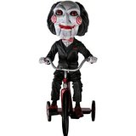
“Let’s Play A Game”

Slide 8
I Need A Volunteer…
Pick A Number Between “0” And “64”
So Not “0” or “64”, But Some Whole Number In Between…
Write It Down
Show It Around… But Don’t Let Me See It
Place it Face Down On Your Table
Now, Tell Me “Yes” Or “No” If Your Number Is On The Next 6 Slides
Ready…

Slide 9
Is Your Number on this card?
1 | 3 | 5 | 7 | 9 | 11 | 13 | 15
17 | 19 | 21 | 23 | 25 | 27 | 29 | 31
33 | 35 | 37 | 39 | 41 | 43 | 45 | 47
49 | 51 | 53 | 55 | 57 | 59 | 61 | 63

Slide 10
Is Your Number on this card?
2 | 3 | 6 | 7 | 10 | 11 | 14 | 15
18 | 19 | 22 | 23 | 26 | 27 | 30 | 31
34 | 35 | 38 | 39 | 42 | 43 | 46 | 47
50 | 51 | 54 | 55 | 58 | 59 | 62 | 63

Slide 11
Is Your Number on this card?
4 | 5 | 6 | 7 | 12 | 13 | 14 | 15
20 | 21 | 22 | 23 | 28 | 29 | 30 | 31
36 | 37 | 38 | 39 | 44 | 45 | 46 | 47
52 | 53 | 54 | 55 | 60 | 61 | 62 | 63

Slide 12
Is Your Number on this card?
8 | 9 | 10 | 11 | 12 | 13 | 14 | 15
24 | 25 | 26 | 27 | 28 | 29 | 30 | 31
40 | 41 | 42 | 43 | 44 | 45 | 46 | 47
56 | 57 | 58 | 59 | 60 | 61 | 62 | 63

Slide 13
Is Your Number on this card?
16 | 17 | 18 | 19 | 20 | 21 | 22 | 23
24 | 25 | 26 | 27 | 28 | 29 | 30 | 31
48 | 49 | 50 | 51 | 52 | 53 | 54 | 55
56 | 57 | 58 | 59 | 60 | 61 | 62 | 63

Slide 14
Is Your Number on this card?
32 | 33 | 34 | 35 | 36 | 37 | 38 | 39
40 | 41 | 42 | 43 | 44 | 45 | 46 | 47
48 | 49 | 50 | 51 | 52 | 53 | 54 | 55
56 | 57 | 58 | 59 | 60 | 61 | 62 | 63

Slide 15
Your Number IS…….

Slide 16
Why Do We Count To 10?
A2
Because We Have 10 Fingers…
What If We Had 3 fingers?
How About If We Only Had 1?
Let’s Learn About The Binary (Base 2) Number System,
But First, Lets Review The Decimal (Base 10) Number System

Slide 17
Base 10 Number System - Place Value
A4
3 9 9 3
10 1 10 1
Which Number is bigger?
39 or 93
3x10 + 9x1 9x10 + 3x1
30 + 9 90 + 3
Place Value
5 6 3 9
1000 100 10 1
____ ____ ____ ____ ____
10000
1000
100
10
1

Slide 18
Base 10 Number System - Place Value
A5
How Do You move from one Place Value to the next?
Place Value
X 10
Why?
Because it’s Base 10
____ ____ ____ ____ ____ ____
??
1000
100
10
1
10000
1
\
0 to 9
11
(10 Digits)
What Digits are allowed for each Place Value?
9
3
____ ____
Only Allowed One Digit Per Place Value
10
1

Slide 19
Figuring Out Other Base Number Systems
A10
16 Digits = F,E,D,C,B,A,9,8,7,6,5,4,3,2,1,0
Place Value
Base 16
Base 2
P.V.
____ ____ ____ ____ ____ ____
x 16
…
x ?
256
16
1
65536
4096
1048576
Place Value
2 Digits = 1,0
P.V.
___
256
____ ____ ____ ____ ____ ____ ____ ____
x ?
??… 128 64 32 16 8 4 2 1
x 2

Slide 20
Base 2 Number System - Place Value
A1
How Do You move from one Place Value to the next?
In Other Words, How Do You Count In Binary
Place Values
____ ____ ____ ____ ____ ____ ____ ____
… 128 64 32 16 8 4 2 1
You Use The Same Rules As Decimal (Base 10)… Just In Binary (Base 2)

Slide 21
Counting In Binary
A1
Remember Binary Numbers are made of 0s and 1s
Here Is An Example Of A Binary Number: 101011
Binary Number can only be made from the Digits 0-1
There is no 2,3,4,5,6,7,8 or 9 in Binary
Lets Start Counting…
Start with 0
Then count to 1
Then ?? There is not symbol for 2
Place Values
Play

Slide 22
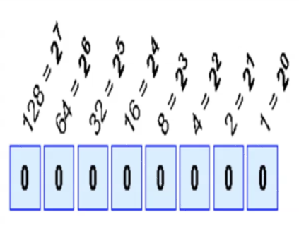
A7
Computer Humor
Binary is as easy as 01, 10, 11
Convert the Following Binary Numbers:
____ ____ ____ ____ ____ ____ ____ ____
… 128 64 32 16 8 4 2 1
Place Values
0011 = ?
1x2 + 1x1 = 3
Place Values
1011 = ?
1x8 + 0x4 + 1x2 + 1x1 = 11
10101 = ?
1x16 + 0x8 + 1x4 + 0x2 + 1x1 = 21
110011 = ?
1x32 + 1x16 + 0x8 + 0x4 + 1x2 + 1x1 = 51

Slide 23
Bits and Bytes?
Decimal (Base 10 ) | Binary (Base 2) | Hex (Base 8)
0 | 0000 0000 | 0
1 | 0000 0001 | 1
2 | 0000 0010 | 2
3 | 0000 0011 | 3
4 | 0000 0100 | 4
5 | 0000 0101 | 5
6 | 0000 0110 | 6
7 | 0000 0111 | 7
8 | 0000 1000 | 8
9 | 0000 1001 | 9
10 | 0000 1010 | A
11 | 0000 1011 | B
12 | 0000 1100 | C
13 | 0000 1101 | D
14 | 0000 1110 | E
15 | 0000 1111 | F
16 | 0001 0000 | 10
How does a computer count?
It Uses The Binary (Base 2) number system?
Bits, Bytes, Words
You See the Number 3, The Computer Sees 0011
BIT
4110 = 0010 1001
25410 = 1111 1110
25510 = 1111 1111
25610 = 0001 0000 0000
0000 0000 0010 1001
BYTE = 8 Bits
WORD = 2 BYTES = 32 Bits
Some Computer Architectures
A WORD = 4 BYTES = 64 Bits
1 BYTE

Slide 24
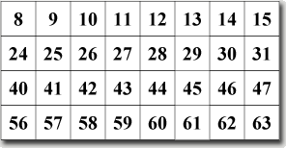
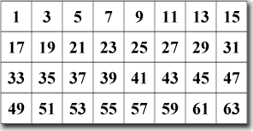
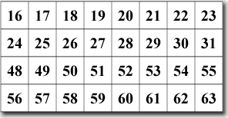
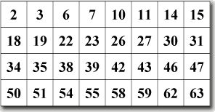
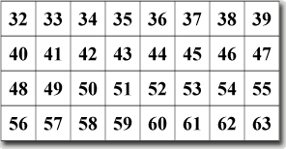
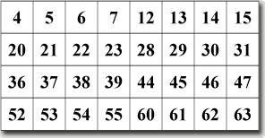
All Six Cards
Decimal (Base 10 ) | Binary (Base 2)
0 | 0000 0000
1 | 0000 0001
2 | 0000 0010
3 | 0000 0011
4 | 0000 0100
5 | 0000 0101
6 | 0000 0110
7 | 0000 0111
8 | 0000 1000
9 | 0000 1001
10 | 0000 1010
11 | 0000 1011
12 | 0000 1100
13 | 0000 1101
14 | 0000 1110
15 | 0000 1111
16 | 0001 0000

Slide 25
All Six Cards
64 = 2⁶
8 = 2³
4 = 2²
2 = 2¹
1 = 2⁰
128 = 2⁷
32 = 2⁵
16 = 2⁴
0 0 0 0 0 1 1 1
= 7

Slide 26
All Six Cards
64 = 2⁶
8 = 2³
4 = 2²
2 = 2¹
1 = 2⁰
128 = 2⁷
32 = 2⁵
16 = 2⁴
0 0 0 0 1 1 0 1
= 13

Slide 27
All Six Cards
64 = 2⁶
8 = 2³
4 = 2²
2 = 2¹
1 = 2⁰
128 = 2⁷
32 = 2⁵
16 = 2⁴
0 0 0 1 0 0 0 0
= 16

Slide 28
All Six Cards
64 = 2⁶
8 = 2³
4 = 2²
2 = 2¹
1 = 2⁰
128 = 2⁷
32 = 2⁵
16 = 2⁴
0 0 0 1 1 0 1 1
= 27

Slide 29
All Six Cards
64 = 2⁶
8 = 2³
4 = 2²
2 = 2¹
1 = 2⁰
128 = 2⁷
32 = 2⁵
16 = 2⁴
0 0 1 0 1 0 0 1
= 41

Slide 30
Ready For a Quiz?
Web based Google Quiz
Decimal 2 Binary Quiz #1
Decimal 2 Binary Quiz #2
Binary 2 Decimal Quiz #3
Binary 2 Decimal Quiz #4
Worksheet Hand Out

Slide 31
Adding Binary Numbers
Rule 1 → 0 + 0 = 0
Rule 2 → 0 + 1 = 1
Rule 3 → 1 + 0 = 1
Rule 4 → 1 + 1 = 10 ← Surprise!
}
Just like
decimal
addition
110
+ 101
1011
Since 0 + 1 =1
Since 1 + 1 = 10
Since 1 + 0 = 1
https://www.quickanddirtytips.com/education/math/how-to-add-binary-numbers?page=1

Slide 32
Multiplying Binary Numbers
}
Rule 1 → 0 * 0 = 0
Rule 2 → 0 * 1 = 0
Rule 3 → 1 * 0 = 0
Rule 4 → 1 * 1 = 1
Just like
decimal
multiplication
110
* 101
1 1 0
0 0 0 0
1 1 0 0 0
11110
https://www.quickanddirtytips.com/education/math/how-to-add-binary-numbers?page=1

Slide 33
Adding and Multipying in Binary
Adding Binary Numbers
Adding in binary | Applying mathematical reasoning
Multiplying Binary Numbers
Multiplying in binary | Applying mathematical reasoning

Slide 34
Reference Slides

Slide 35
Resources & Materials
Lecture Slides (PDF)
Student Worksheets (PDF) or Link to Google Quiz
Student “Let’s Play A Game” Handout & Instructions

Slide 36
Appendix

Slide 37
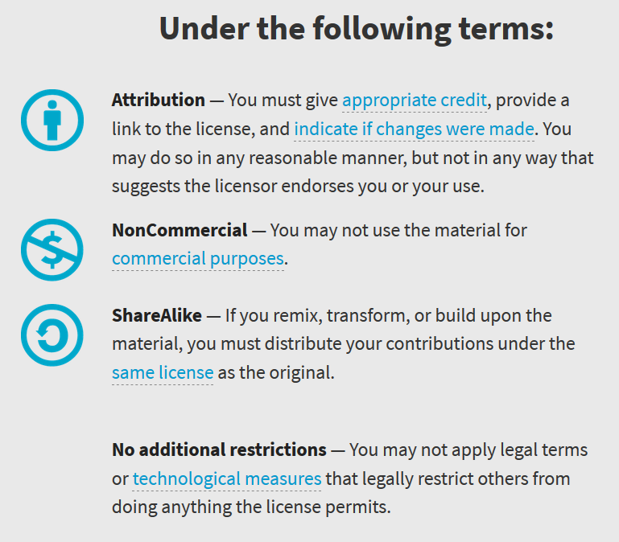
Appendix A: License & Attribution
This interpretation is primarily the Intellectual Property of Jim Burnham, Top STEAM Clown, at STEAMClown.org
This presentation and content is distributed under the Creative Commons License CC-by-nc-sa-3.0
My best attempt to properly attribute, or reference any other sources or work I have used are listed in Appendix B

Slide 38
Appendix B: Attribution for Sources Used
Decimal/Binary Conversion Quiz - http://acc6.its.brooklyn.cuny.edu/~gurwitz/core5/binquiz.html
Online Magic - http://avimagic.com/tricks/number_cards.php
Binary Trick - http://www.mathmaniacs.org/lessons/01-binary/Magic_Trick/
Work sheet - http://www.cse4k12.org/binary/magic_trick.html
Magic Binary Cards - http://www.northeastern.edu/seigen/11Magic/Binary/Magic_binary_cards.pdf
Base 5 Number System – Basics - https://www.youtube.com/watch?v=qGi29E9q_f0
Binary Number System - https://www.mathsisfun.com/binary-number-system.html
Bits, bytes and words - http://www.plainenglish.info/Computer+Science/Computer+Architecture/Bits%2C+bytes+and+words

